Slide 1
2-way ANOVA
Examples: Balanced Designs
One with interaction and one without interaction affect

Slide 2
Suppose the USGA tests four different brands (A,B,C,D) of golf balls and two different clubs(driver, five-iron). Each of the eight Brand-Club combinations (treatments) is randomly and independently assigned to a sequence of hits by the mechanical driver. The distance response is recorded for each of the 32 hits
This experiment has how many factors?
Two – type of club and brand of ball
Type of golf ball has how many levels?
Four
Type of club has how many levels?
Two
There are how many treatments?
Eight

Slide 3
 | Brand A | Brand B | Brand C | Brand D
Driver | 226.4 232.6 234.0 220.7 | 238.3 231.7 227.7 237.2 | 240.5 246.9 240.3 244.7 | 219.8 228.7 232.9 237.6
Five-iron | 163.8 179.4 168.6 173.4 | 184.4 180.6 179.5 186.2 | 179.0 168.0 165.2 156.5 | 157.8 161.8 162.1 160.3

Slide 4
 | Brand A MEAN=199.8625 | Brand B MEAN=208.2 | Brand C MEAN=205.1375 | Brand D MEAN=195.125
Driver MEAN=233.75 | 226.4 232.6 234.0 220.7 Sum=913.7 Mean= 228.425 | 238.3 231.7 227.7 237.2 Sum=934.9 Mean=233.725 | 240.5 246.9 240.3 244.7 Sum=972.4 Mean=243.1 | 219.8 228.7 232.9 237.6 Sum=919 Mean=229.75
Five-iron MEAN=170.4125 | 163.8 179.4 168.6 173.4 Sum=685.2 Mean=171.3 | 184.4 180.6 179.5 186.2 Sum=730.7 Mean=182.675 | 179.0 168.0 165.2 156.5 Sum=668.7 Mean=167.175 | 157.8 161.8 162.1 160.3 Sum=642 Mean=160.5

Slide 5
Source of Variation | Degrees of Freedom | Sum of Squares | Mean Square | Variance Ratio, F | P-value
Factor A (row factor) | r-1 | SSA | MSA= |  | F_{r-1,rc(n-1)}
Factor B (column factor) | c-1 | SSB | MSB= |  | F_{c-1,rc(n-1)}
AxB (Interaction) | (r-1)(c-1) | SSAB | MSAB= |  | F_{(r-1)(c-1),rc(n-1)}
Error (Residual) | rc(n-1) | SSE | MSE=
Total | N-1

Slide 6
Computational Forms
SSA = ΣR²/nc - G²/N
(Sum of the squares of the row totals divided by the number of observations per row) – (square of grand total divided by the total number of observations)
SSA =
= 32093.11125

Slide 7
SSB = ΣC²/nr - G²/N
(Sum of the squares of the column totals divided by the number of observations per column) – (square of grand total divided by the total number of observations)
SSB=
= 800.73625

Slide 8
SSE = ΣX² – ΣT²/n
(Sum of the squares of all the observations) – (the sum of the squares of each cell total divided by the number of observations per cell)
SSE = 1341261 -
= 882.24

Slide 9
SS(Total) = ΣX² – G²/N
(Sum of the squares of all the observations) – (square of grand total divided by the total number of observations)
SS(Total) = 1341261-
= 34482.04875

Slide 10
Source of Variation | Degrees of Freedom | Sum of Squares | Mean Square | Variance Ratio, F | P-value
Factor A (row factor) | r-1= 2-1=1 | SSA= 32093.1112 | MSA= |  | F_{r-1,rc(n-1)}
Factor B (column factor) | c-1= 4-1=3 | SSB= 800.7362 | MSB= |  | F_{c-1,rc(n-1)}
AxB (Interaction) | (r-1)(c-1) (2-1)(4-1)= 3 | SSAB= 765.96125 | MSAB= |  | F_{(r-1)(c-1),rc(n-1)}
Error (Residual) | rc(n-1)= 2*4(4-1) =24 | SSE=882.24 | MSE=
Total | 32-1=31 | 34482.0487

Slide 11
ANOVA Table – computational formulas
Source of Variation | Degrees of Freedom | Sum of Squares | Mean Square | Variance Ratio
Between Rows | r-1 | ΣR²/nc - G²/N | MSA
Between Columns | c-1 | ΣC²/nr - G²/N | MSB
Interaction | (r-1)(c-1) | By subtraction | MSAB
Residual | rc(n-1) | ΣX² – ΣT²/n | MSE
Total | rcn-1 | ΣX² – G²/N

Slide 12
Source | DF | SS | MS | F-Stat | P-value
CLUB | 1 | 32093.111 | 32093.111 | 936.75164 | <0.0001
BRAND | 3 | 800.73625 | 266.91208 | 7.7907788 | 0.0008
Interaction | 3 | 765.96125 | 255.32042 | 7.4524348 | 0.0011
Error | 24 | 822.24 | 34.26
Total | 31 | 34482.049

Slide 13
Checking Assumptions
1) Random and independent samples of experimental units are associated with each treatment – examine the design of the experiment.
2) The response distribution of each factor-level combination is normal
3) The response variance is constant for all treatment.

Slide 14
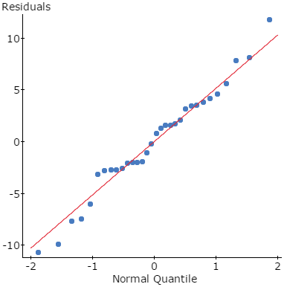
2) The response distribution of each factor-level combination is normal
Steps:
Save both the residuals and fitted values when conducting the 2-way ANOVA analysis on StatCrunch
2) Construct and interpret a QQ plot of the residuals.

Slide 15
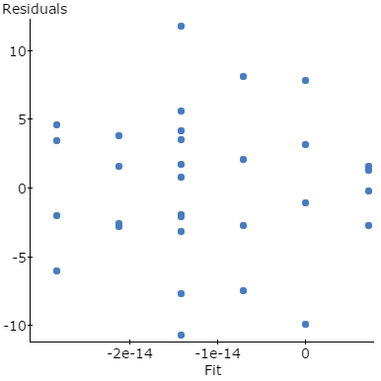
3) The response variance is constant for all treatment
1) Construct a scatterplot of the residuals vs fitted values.
2) Note that there is no pattern in the residual plot – this is good as we do not want to see a pattern in this plot.

Slide 16
Hypothesis Tests
Hypothesis #1
Conclusion and Justification
H_{o} : The factors of club and ball brand do not interact to affect the response mean
H_{a} :The factors of club and ball brand do interact to affect the response mean
As the p-value of .0011 which is much less than the significance level of 0.05, we reject the null hypothesis. Therefore there is evidence that brand interacts with the type of ball to affect the mean distance.

Slide 17
Conclusion
Because the factors interact, we do not test the main effects for Brand and Club. We will compare the treatment means in an attempt to learn the nature of the interaction.
Note:
Examine treatment means from slide #4
StatCrunch will conduct Tukey’s HSD
Construct and examine response plots

Slide 18
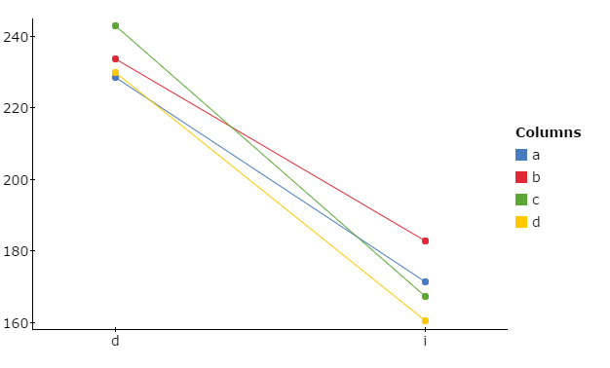
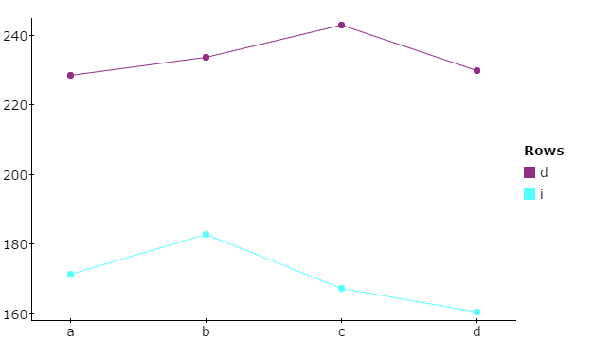
Response Plots

Slide 19
Distance Data for Second Factorial Golf Experiment
The USGA decides to conduct another experiment using four different brands of golf balls and two types of clubs.
Test for Interaction
H_{o} : The factors of club and ball brand do not interact to affect the response mean
H_{a} :The factors of club and ball brand do interact to affect the response mean

Slide 20
Additional Hypotheses
Test for Main Effect of Club Type
Test for Main Effect of Golf Ball Brand
H_{o} : There is no difference among the four means for type of golf ball.
H_{a} : There is a difference among the four means for type of golf ball.
H_{o} : There is no difference among the two distance means for type for the two clubs.
H_{a} : There is a difference among the two distance means for type for the two clubs.

Slide 21
Recall the Assumptions for all Tests
The response distribution for each factor-level combination is normal.
The response variance is constant for all treatments
Random and independent samples of experimental units are associated with each treatment

Slide 22
 | Brand E | Brand F | Brand G | Brand H
Driver | 238.6 241.9 236.6 244.9 | 261.4 261.3 254.0 259.9 | 264.7 262.9 253.5 255.6 | 235.4 239.8 236.2 237.5
Five-iron | 165.2 156.9 172.2 163.2 | 179.2 171.0 178.0 182.7 | 189.0 191.2 191.3 180.5 | 171.4 159.3 156.6 157.4

Slide 23
Source | DF | SS | MS | F-Stat | P-value
Club | 1 | 46443.9 | 46443.9 | 1887.9394 | <0.0001
Ball | 3 | 3410.3159 | 1136.772 | 46.209656 | <0.0001
Interaction | 3 | 105.15844 | 35.052812 | 1.424893 | 0.26
Error | 24 | 590.4075 | 24.600312
Total | 31 | 50549.782

Slide 24
Results and Conclusions
Hypothesis #1
Conclusion and Justification
H_{o} : The factors of club and ball brand do not interact to affect the response mean
H_{a} :The factors of club and ball brand do interact to affect the response mean
As the p-value of .26 is greater than the significance level of 0.05, we fail to reject the null hypothesis. Therefore there is no evidence that brand interacts with the type of ball

Slide 25
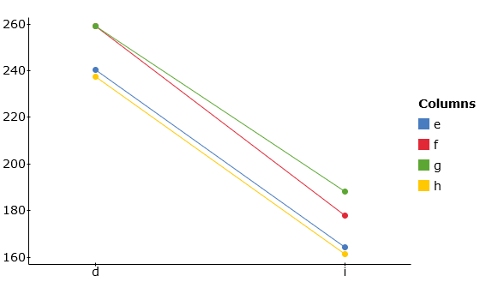
Interaction Plot

Slide 26
Hypothesis #2
Conclusion and Justification
H_{o} : There is no difference among the two distance means for type for the two clubs.
H_{a} : There is a difference among the two distance means for type for the two clubs.
As the p-value is less than 0.05, we reject the null hypothesis and conclude that there is a difference in the mean distances for the two types of clubs.

Slide 27
Hypothesis #3
Conclusion and Justification
H_{o} : There is no difference among the four means for type of golf ball.
H_{a} : There is a difference among the four means for type of golf ball.
As the p-value is less than 0.05, we reject the null hypothesis and conclude that there is a difference in the mean distances for the four types of golf ball brands.

Slide 28
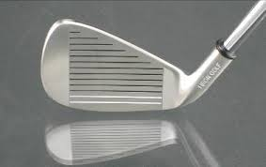

Follow-up
As there are only two types of clubs, an F-test leads to the inference that there is a difference in distances for the two types of clubs. It is no surprise to golfers that the mean distance for balls hit with a driver is significantly greater than the mean distance for balls hit with an iron.

Slide 29
Follow-up
To determine which brand means differ we can use the Fisher’s LSD method
LSD = t₂₄ = 2.064(2.4799)=5.1186

Slide 30
Mean of Brand E = 202.4375
Mean of Brand F = 218.4375
Mean of Brand G= 223.5875
Mean of Brand H= 199.20
While there is no significant difference between E and H or G and F. It appears that both Brands G and F have a significantly great mean distance than both Brands E and H as these means differ by more than 5.11.

